Slide 1

Final Project: Suicide Analysis
ALY6040 - Data Mining Application
Siyang Feng

Slide 2
Contents
Dataset Introduction
Data Wrangling
Exploratory Data Analysis
Modeling – panel data regression
Conclusion

Slide 3
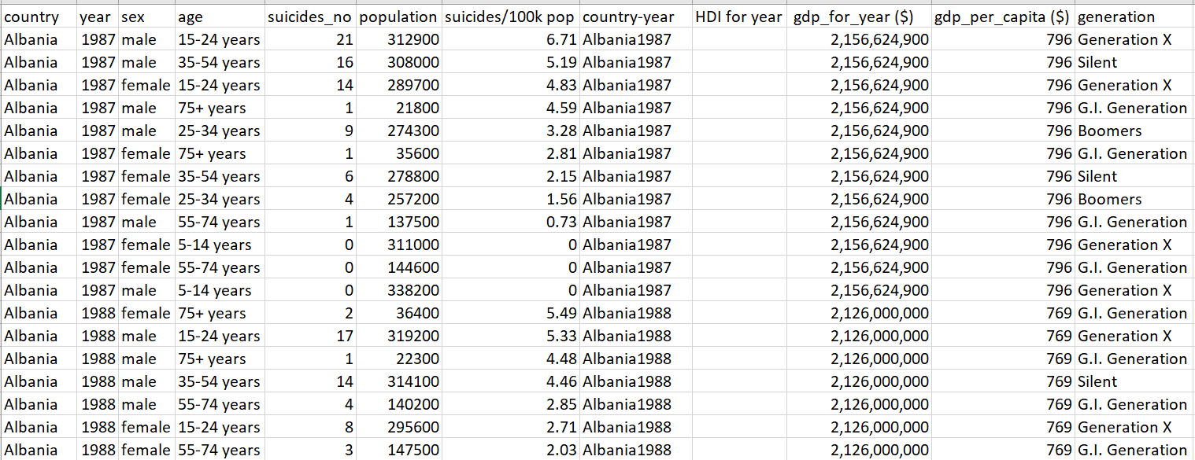
Dataset Introduction
It is the 10th largest cause of death in USA.
In average, there are 129 suicides per day.
Dataset from Kaggle:
  Suicide Rates Overview 1985 to 2016

Slide 4
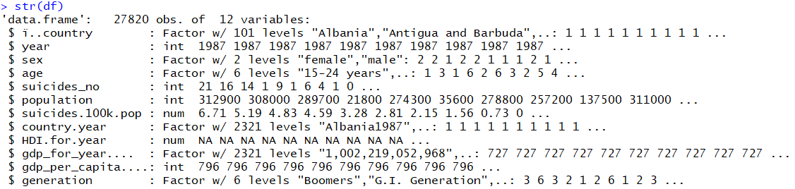
Dataset and Aim
Dataset structure
Research Aim
How do the variables influence the suicide rate
Find out the high risk conditions of suicide

Slide 5
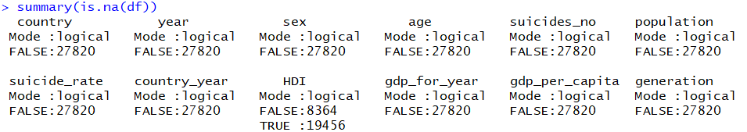
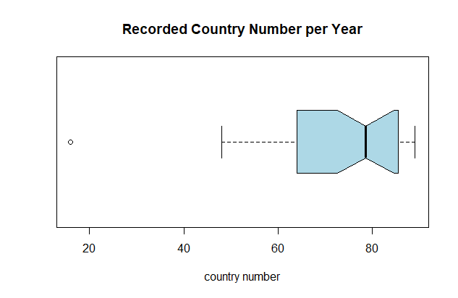
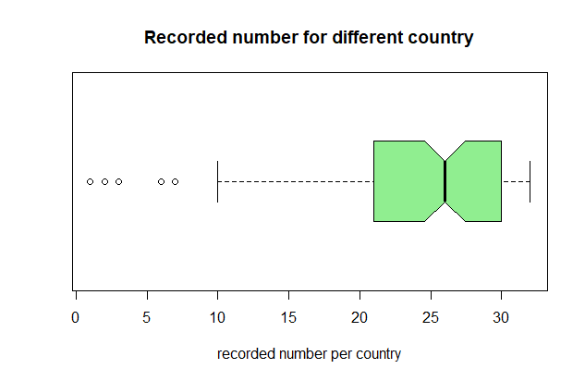
Data wrangling
Change Column names
  Change the nonstandard column names
Change the data type of some columns
  GDP for year (factor to numeric)
Process on NA values
  NA value in HDI column
Outliers
  Less records in 2016
  Less records in some countries

Slide 6
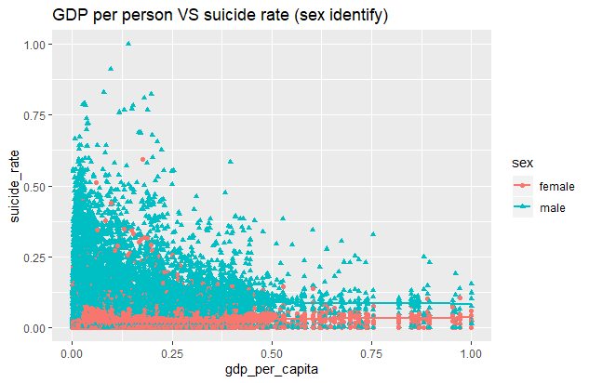
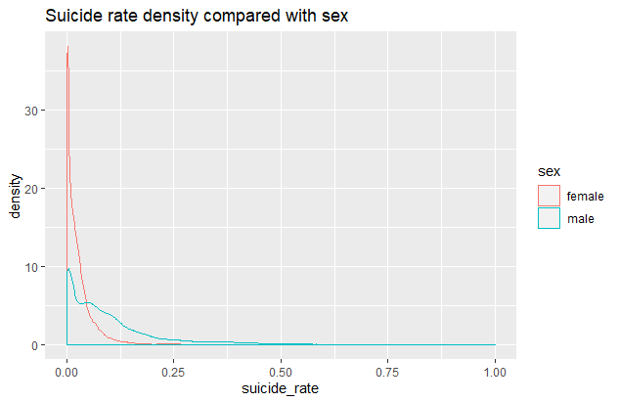
Exploratory Data Analysis

Slide 7
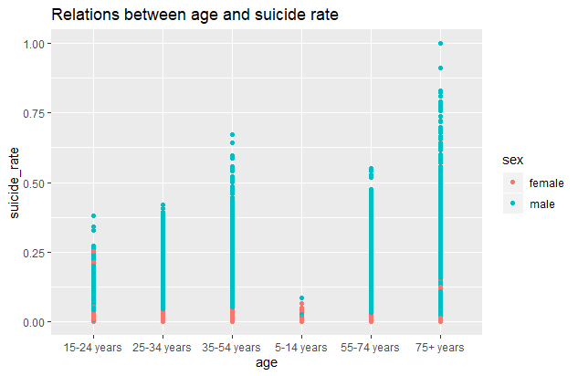
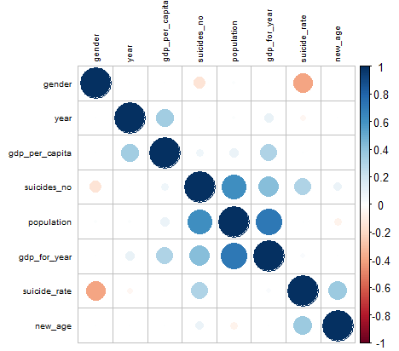
Exploratory Data Analysis

Slide 8
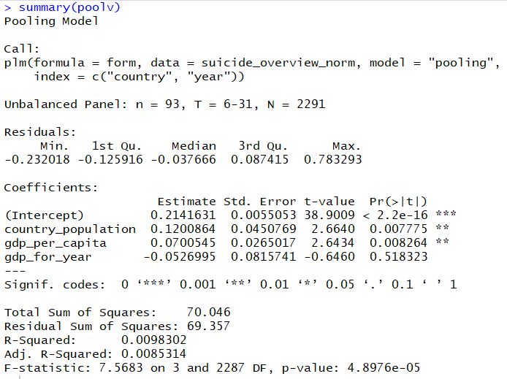
Modeling – panel data regression
Linear Panel Data regression
Non-linear Panel data regression
5 models (linear)
  Pooled Ordinary Least Squares (OLS) Model
  Between Estimation Model
  First differences Estimation Model
  Fixed Effects Model
  Random Effects Model

Slide 9
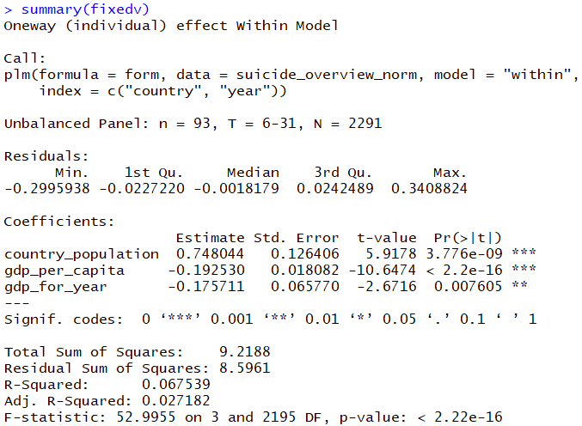
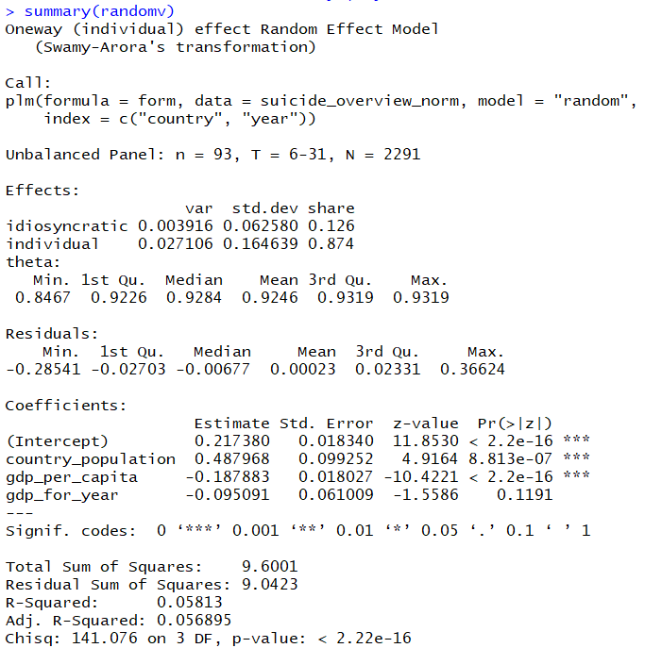
Modeling – panel data regression

Slide 10
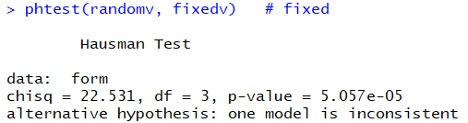
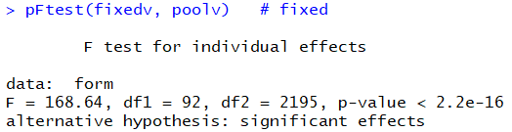
Testing Model
Hausman Testing
  Fixed vs random
pFtest
  Pooled OLS vs fixed

Slide 11
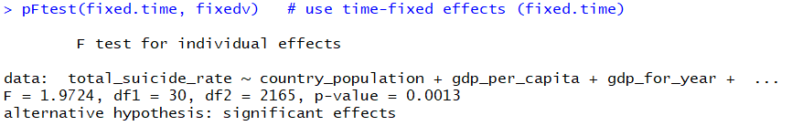
Testing Model – fixed effects
Time-fixed effects model vs fixed effects model
pFtest
Best model: time-fixed effects model
R-square: 0.092346

Slide 12
Conclusion
Suicide rate is related with:
  Gender (male)
  Age (75+)
  Country
  Population (positive)
  GDP (negative)
Why the model has low R-square?
  Panel regression doesn’t include gender and age
  Linear panel regression
  Only GDP and population are included in panel regression model

Slide 13
Thanks

